Slide 1
Car Accident Detection System
Astha Sinha
Shreya Srivastav
Suraj Krishna

Slide 2
Progress
Accomplishment 1
Accelerometer max and min limits set as 100 and -100 respectively.
The accelerometer makes judgement based on difference between average of first 10 readings and the current reading.
Accelerometer detects that an accident has occurred.
Accomplishment 2
GPS module is able to fetch longitude and latitude values of the location where the accident has occurred.

Slide 3
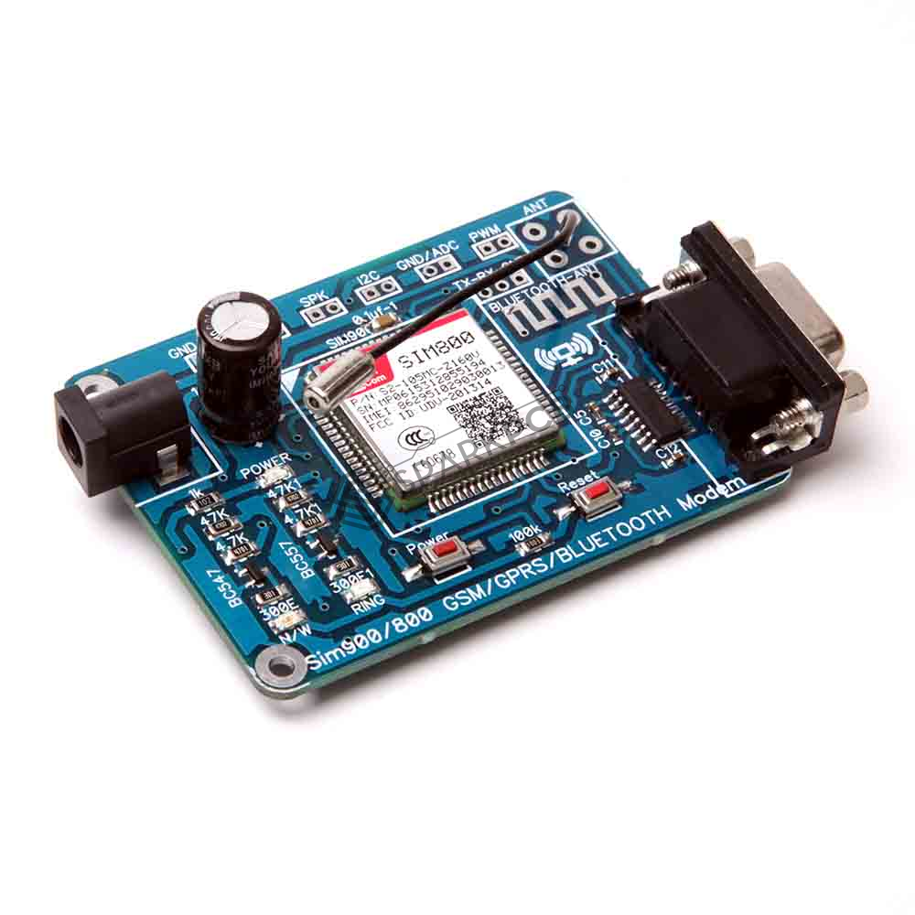
GSM Module SIM900- Overview
Make, receive or reject voice calls
Send, receive or delete SMS messages in the SIM Card
Add, read and search the contacts in the SIM Card
Send and receive data to / from the GSM/GPRS Network through GPRS
All of the above is done by using AT commands.

Slide 4
Specifications Of GSM Module
Supports communication in 850MHz, 900MHz, 1800MHz and 1900MHz.
Requires a 5 volts dc supply is used.
It is controlled via AT commands.
Has a case to insert sim card & antenna to connect to a network.
Can feed data directly to Arduino if the module is enabled with TTL output pins.
Otherwise convert the RS232 data to TTL using MAX232 IC and feed it to Arduino.

Slide 5
Working of GSM Module
Upon switching on the GSM module, it will take some time to establish a connection with mobile network. If successful, the status/network LED will blink continuously every 3 seconds. On calling the SIM card, you hear a ring back, the GSM module has successfully established a network connection. The communication between Arduino and GSM module is serial so use the serial pins of Arduino (Rx and Tx). Now connecting the ground pin of arduino to ground pin of GSM module, we can then start testing the module.

Slide 6
AT commands
There are different AT commands for different tasks. AT Commands to Send SMS using Arduino and GSM Module:
AT+CMGF=1 // Set the GSM module in sms sending mode AT+CMGS=\"+YYxxxxxxxxxx\"\r // Input the mobile number| YY is country code “the message” with stopping character (char)26 which is the ASCII of ctrl+z
Notes:
AT +CMGS is AT command for sending message

Slide 7
GSM Module Interfacing Functions
void gsm(float latt, float longi) - This function takes in the latitude and longitude as parameters and sends a message to a person whose phone number is specified using the AT commands.
After every AT command void updateserial() is called to check if the GSM module is responding correctly.

Slide 8
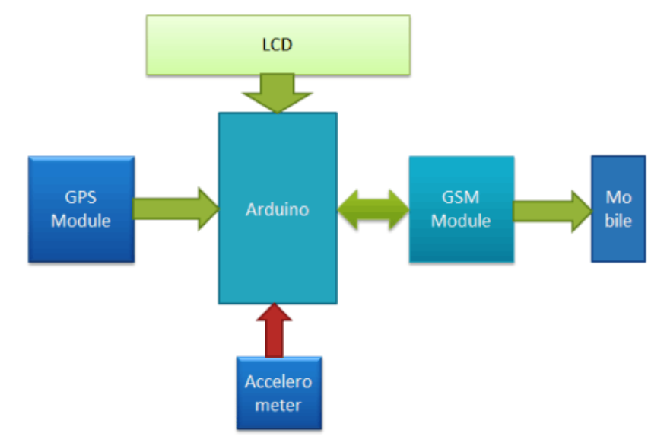
Progress
Accomplishment 3
GSM module receives the longitude and latitude values and sends them to the configured phone numbers.
All modules are integrated and work together.
Goals not achieved yet:
LCD display not yet integrated.

Slide 9
Applications
Reduce number of deaths occuring due to road accidents by alerting nearby hospitals by its quick alert mechanism.
Can be used by police to fight crimes and hit-run cases.
The criticality of the accident with the patient details can also be sent to the insurance agency.
Tracking of assets as well as live location fetching of vehicles.
Safety tool for school buses.

Slide 10

Future Scope
This project can be integrated with IoT concepts to operate the vehicle remotely by anyone from anywhere in the world. It can be arranged in such a way that it can connect to the owner.
It implemented well, finds a use in ALTACAS which is an automated system designed to monitor aircraft runways acting as an anti-collision system during landing and take-off of aircrafts.

Slide 11
Further possible add-ons to our project
Use machine learning to predict possibility of occurrence of an accident at locations where accidents are prone to happen and intimate the same to driver.
We can dial an automated emergency call if the vehicle goes out of a certain / pre-decided track.
Drink and Drive Accident Detection: placing an alcohol sensor at the steering.

